Slide 1



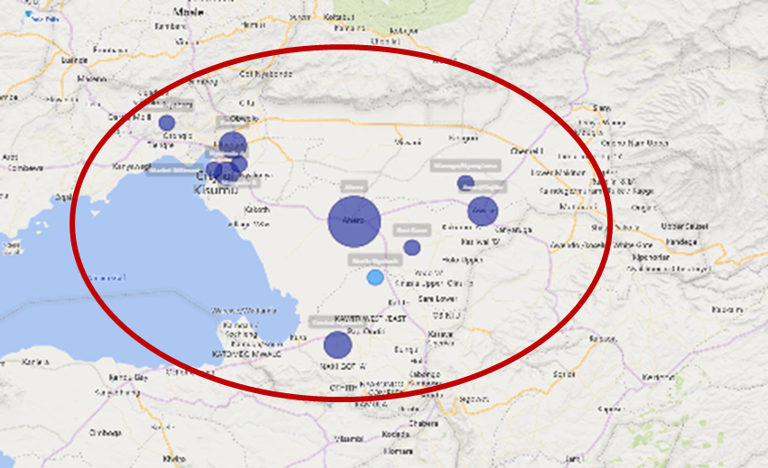
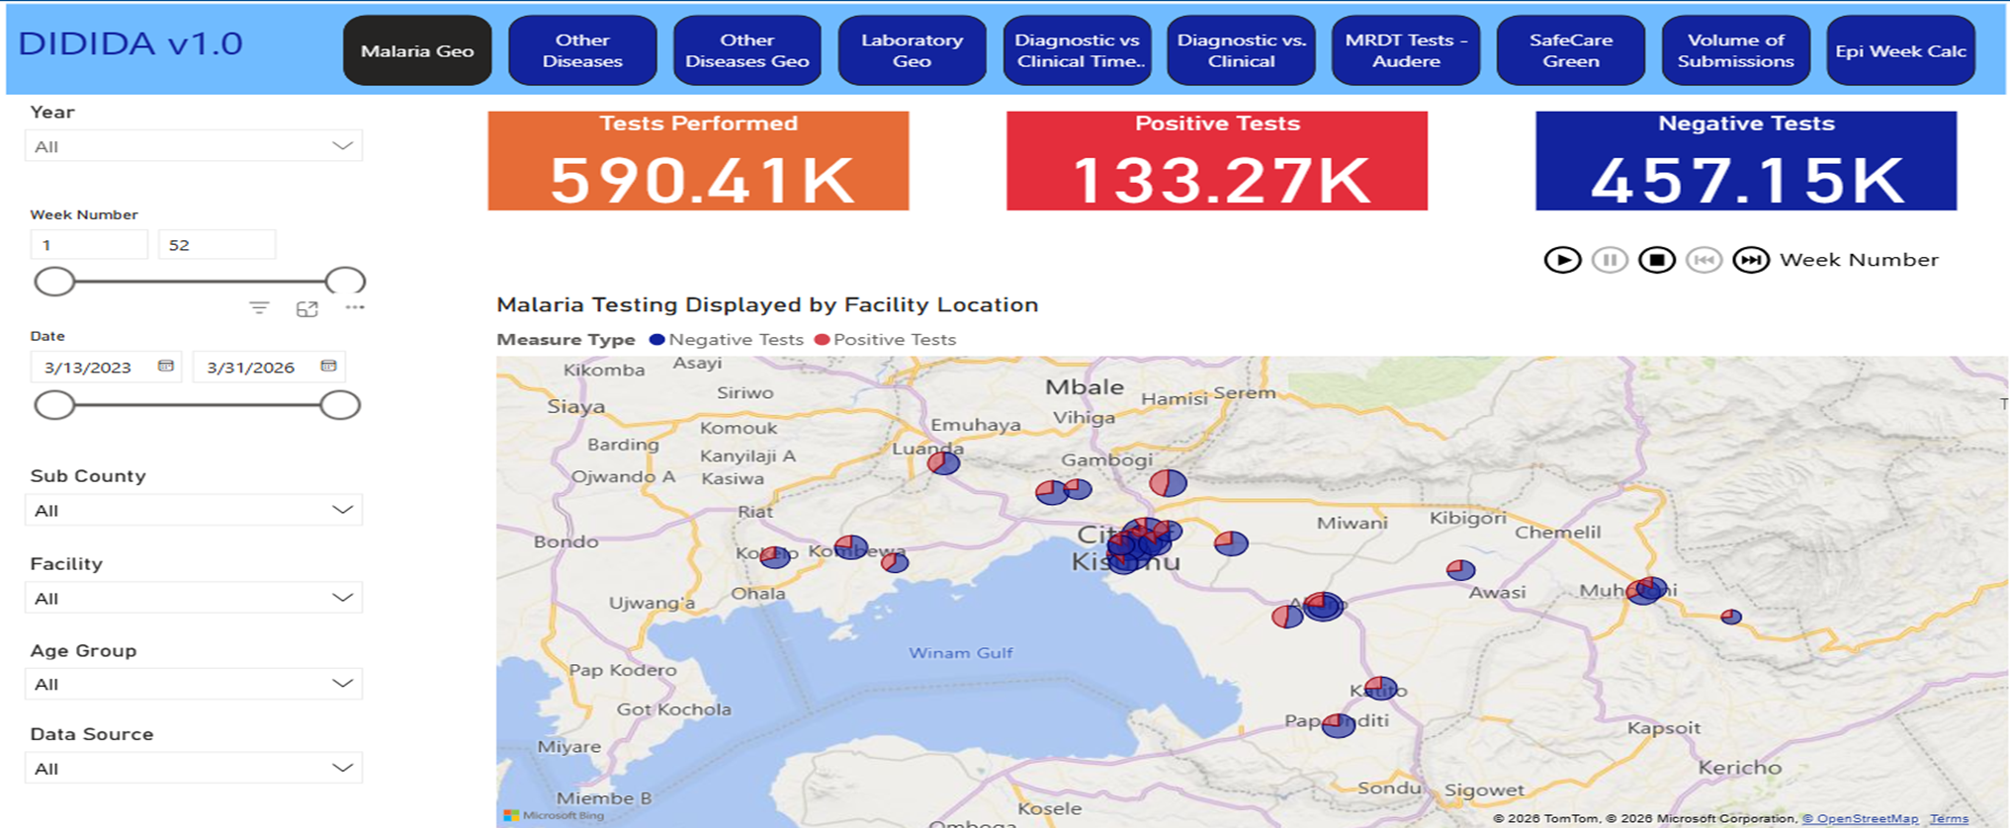
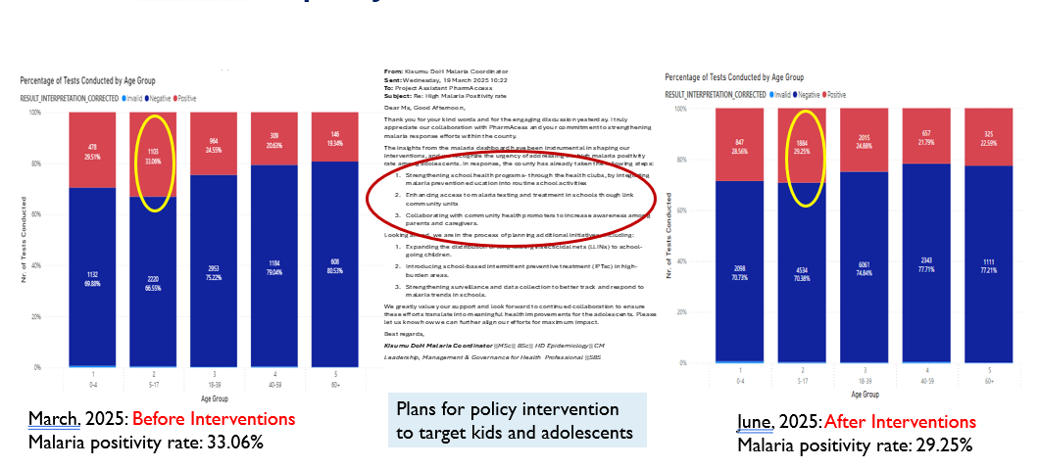





Digital Strengthening of Disease Surveillance and Diagnostic Readiness for Epidemic Preparedness in Kisumu County, Kenya: The DIDIDA Project
Naomy Onyuka¹,Felix Bahati², Kevin Owuor², Lisette Schutte¹, Alloys K’Oloo^{1,2}, Cem Koyuncu¹, Nathalie Houben ¹ , Simon Kariuki², John Waitumbi⁵, Philip Agutu⁶, Fredrick Oluoch⁶, Gregory Ganda⁶, Jonathan M. Cooper⁴, Tobias F. Rinke de Wit^{1,3}
1:PharmAccess Foundation 2: Centre for Global Health Research, Kenya Medical Research Institute, Kisumu, Kenya 3:Amsterdam Institute for Global Health and Development 4: School of Engineering, College of Science and Engineering, University of Glasgow, Glasgow, Scotland, United Kingdom 5: Walter Reed Army Institute of Research, Kisumu 6:Ministry of Health, Kisumu County, Kenya
BACKGROUND
Timely epidemic detection depends on complete and rapid reporting through the Integrated Disease Surveillance and Response (IDSR) system. In many resource-limited settings, surveillance remains paper-based and diagnostic confirmation is limited. The DIDIDA project in Kisumu County, Kenya addresses these gaps by strengthening digital surveillance, introducing diagnostic innovations, and integrating One Health monitoring to improve epidemic preparedness.
METHODOLOGY:
Initiated in April 2023, DIDIDA operates in 25 health facilities serving ~39% of Kisumu County’s population. In collaboration with the County Ministry of Health, the MoH 505 tool was digitized using Kobo for near real-time IDSR reporting. Data are visualized through a Power BI dashboard enabling disease trend monitoring, hotspot mapping, laboratory tracking, and reporting completeness. Quarterly review meetings with the Department of Health were institutionalized to support data-driven decision-making. The project also integrates wastewater surveillance and supports development of affordable rapid diagnostic tests.
STUDY AREA: Kisumu, Kenya
RESULTS
Traditionally, surveillance data are compiled at facility level, verified at sub-county level, and submitted to the national Kenya Health Information System, often taking days or weeks. DIDIDA enables direct facility-level reporting, improving timeliness, accuracy, and access to real-time insights. Since April 2023, over one million surveillance records have been generated. Malaria testing reached 99.0% (133,3270/590,410) with 23% positivity, while typhoid testing reached 95.9% (13,174/13,738). Use of DIDIDA data informed response actions, including rapid containment of the May 2025 cholera outbreak, targeted malaria interventions among adolescents with a reduction in positivity (33% to 29%), and strengthened preparedness for emerging threats such as mpox.
Figure 2: Real-time cholera dashboard displaying geo-mapped health facilities and cholera suspected cases
Figure 1: Real-time dashboard displaying geo-mapped health facilities and malaria prevalence
Figure 3: Real-time malaria dashboard visuals showing malaria positivity rate across age-groups
CONCLUSIONS
Digital strengthening of IDSR systems, combined with diagnostic innovation and routine data review, enhances epidemic preparedness and enables timely, data-driven public health action.
Contact: [n.onyuka@pharmaccess.or.ke]

